Slide 1
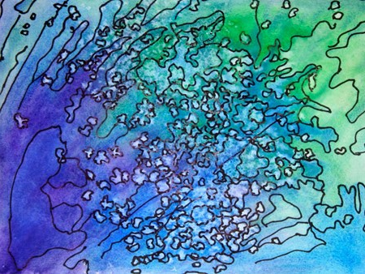
Abstract Watercolor

Slide 2
Using a variety of watercolor techniques, fill your watercolor paper with color
http://www.watercolorpaintingandprojects.com/techniques/techniques.html

Slide 3
Using a variety of watercolor techniques, fill your watercolor paper with color
http://www.watercolorpaintingandprojects.com/techniques/techniques.html
Let dry

Slide 4
Using a variety of watercolor techniques, fill your watercolor paper with color
http://www.watercolorpaintingandprojects.com/techniques/techniques.html
Let dry
Outline using extra fine point Sharpie pen

Slide 5
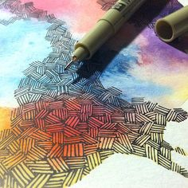
Using a variety of watercolor techniques, fill your watercolor paper with color
http://www.watercolorpaintingandprojects.com/techniques/techniques.html
Let dry
Outline using extra fine point Sharpie pen
Consider adding pattern/design to your piece

Slide 6
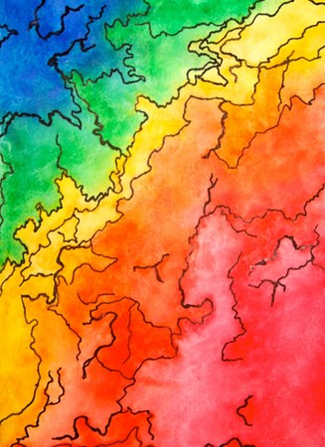

Slide 7
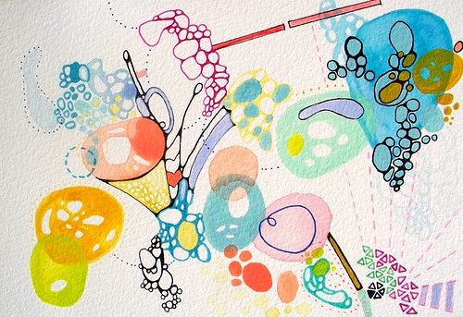

Slide 8
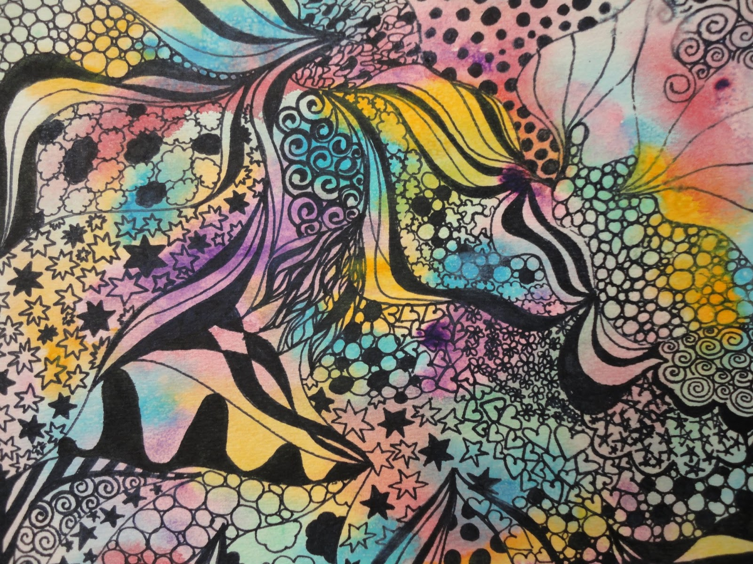

Slide 9
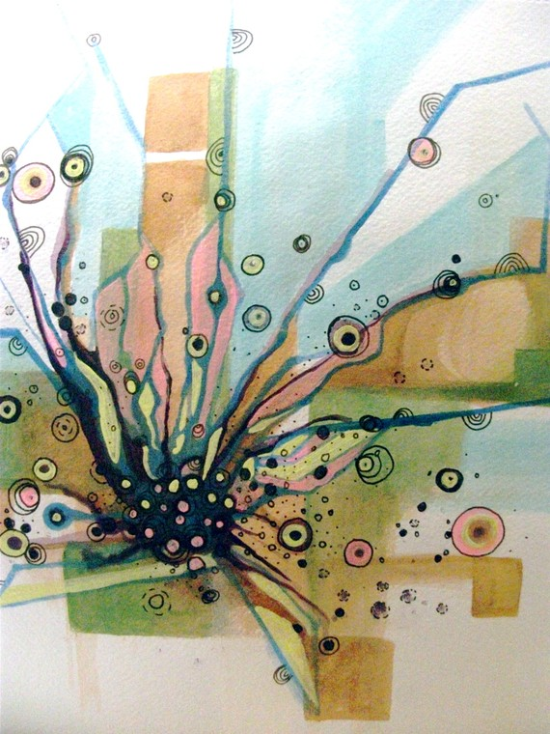

Slide 10
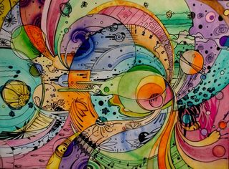

Slide 11
Abstract Watercolor

