Slide 1
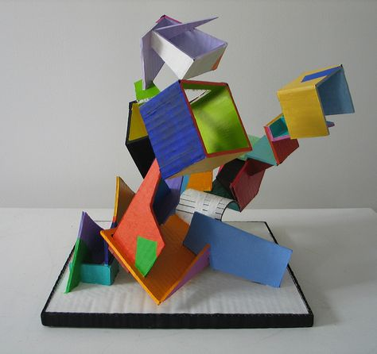
Cardboard Sculpture

Slide 2
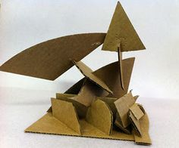

Slide 3
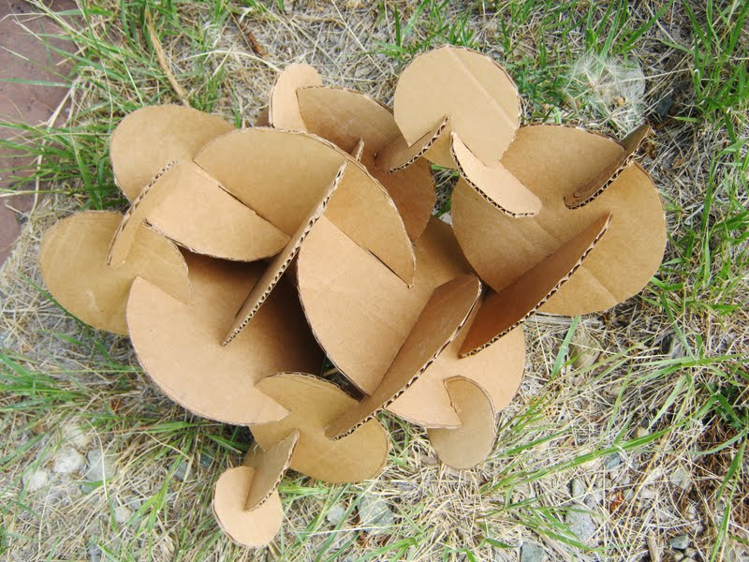

Slide 4
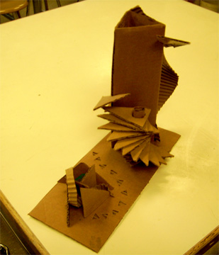

Slide 5
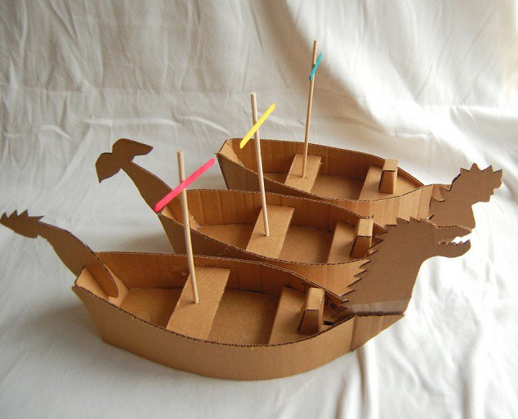

Slide 6
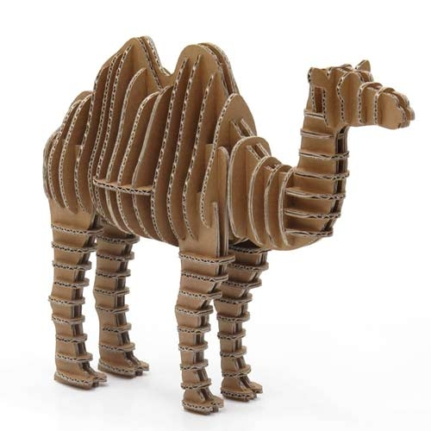

Slide 7
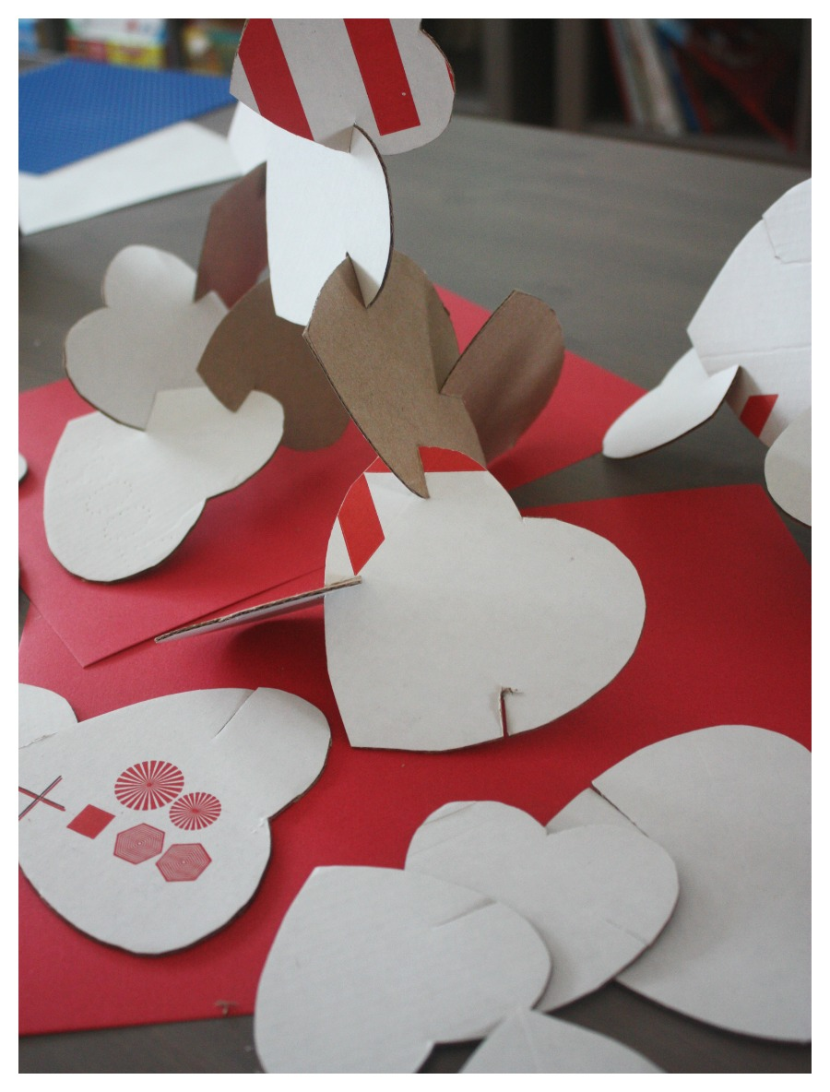

Slide 8
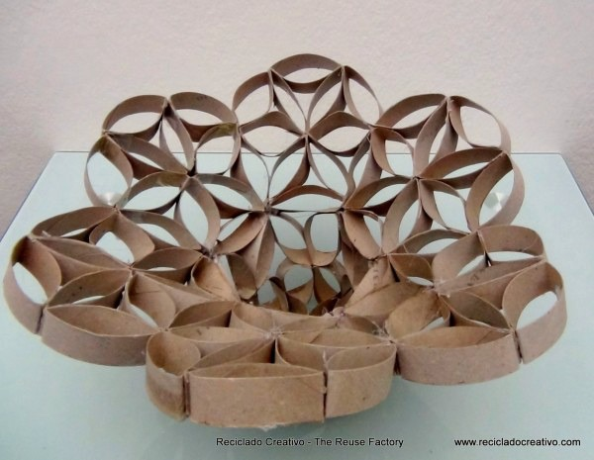

Slide 9
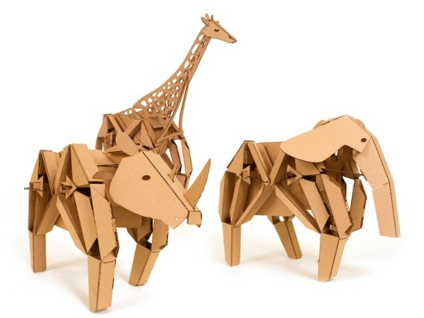

Slide 10
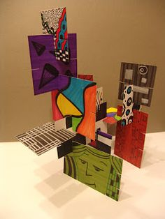

Slide 11
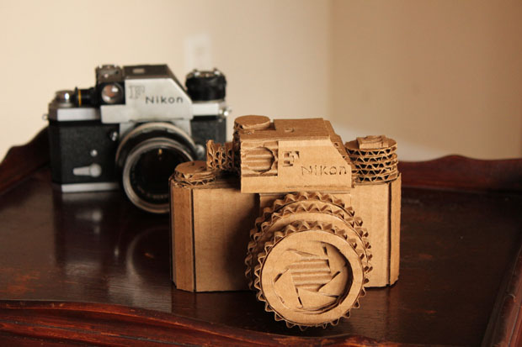

Slide 12
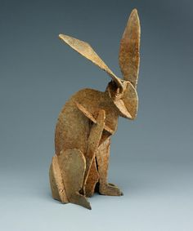

Slide 13
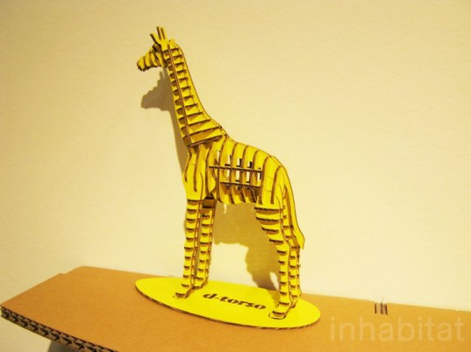

Slide 14
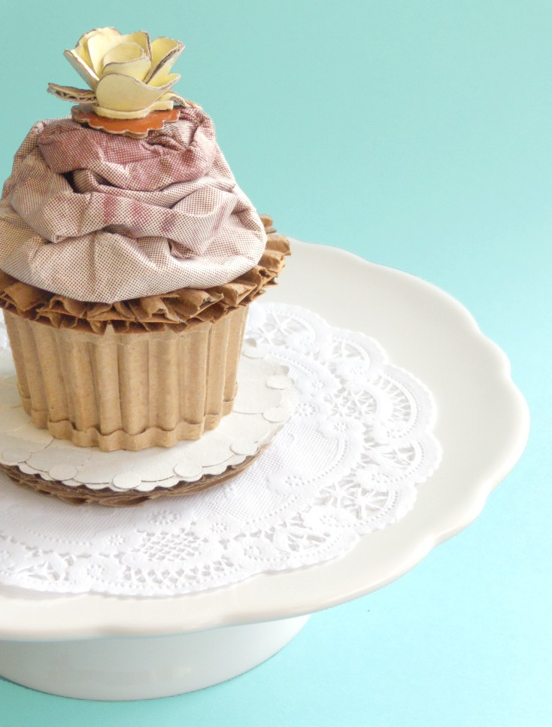

Slide 15
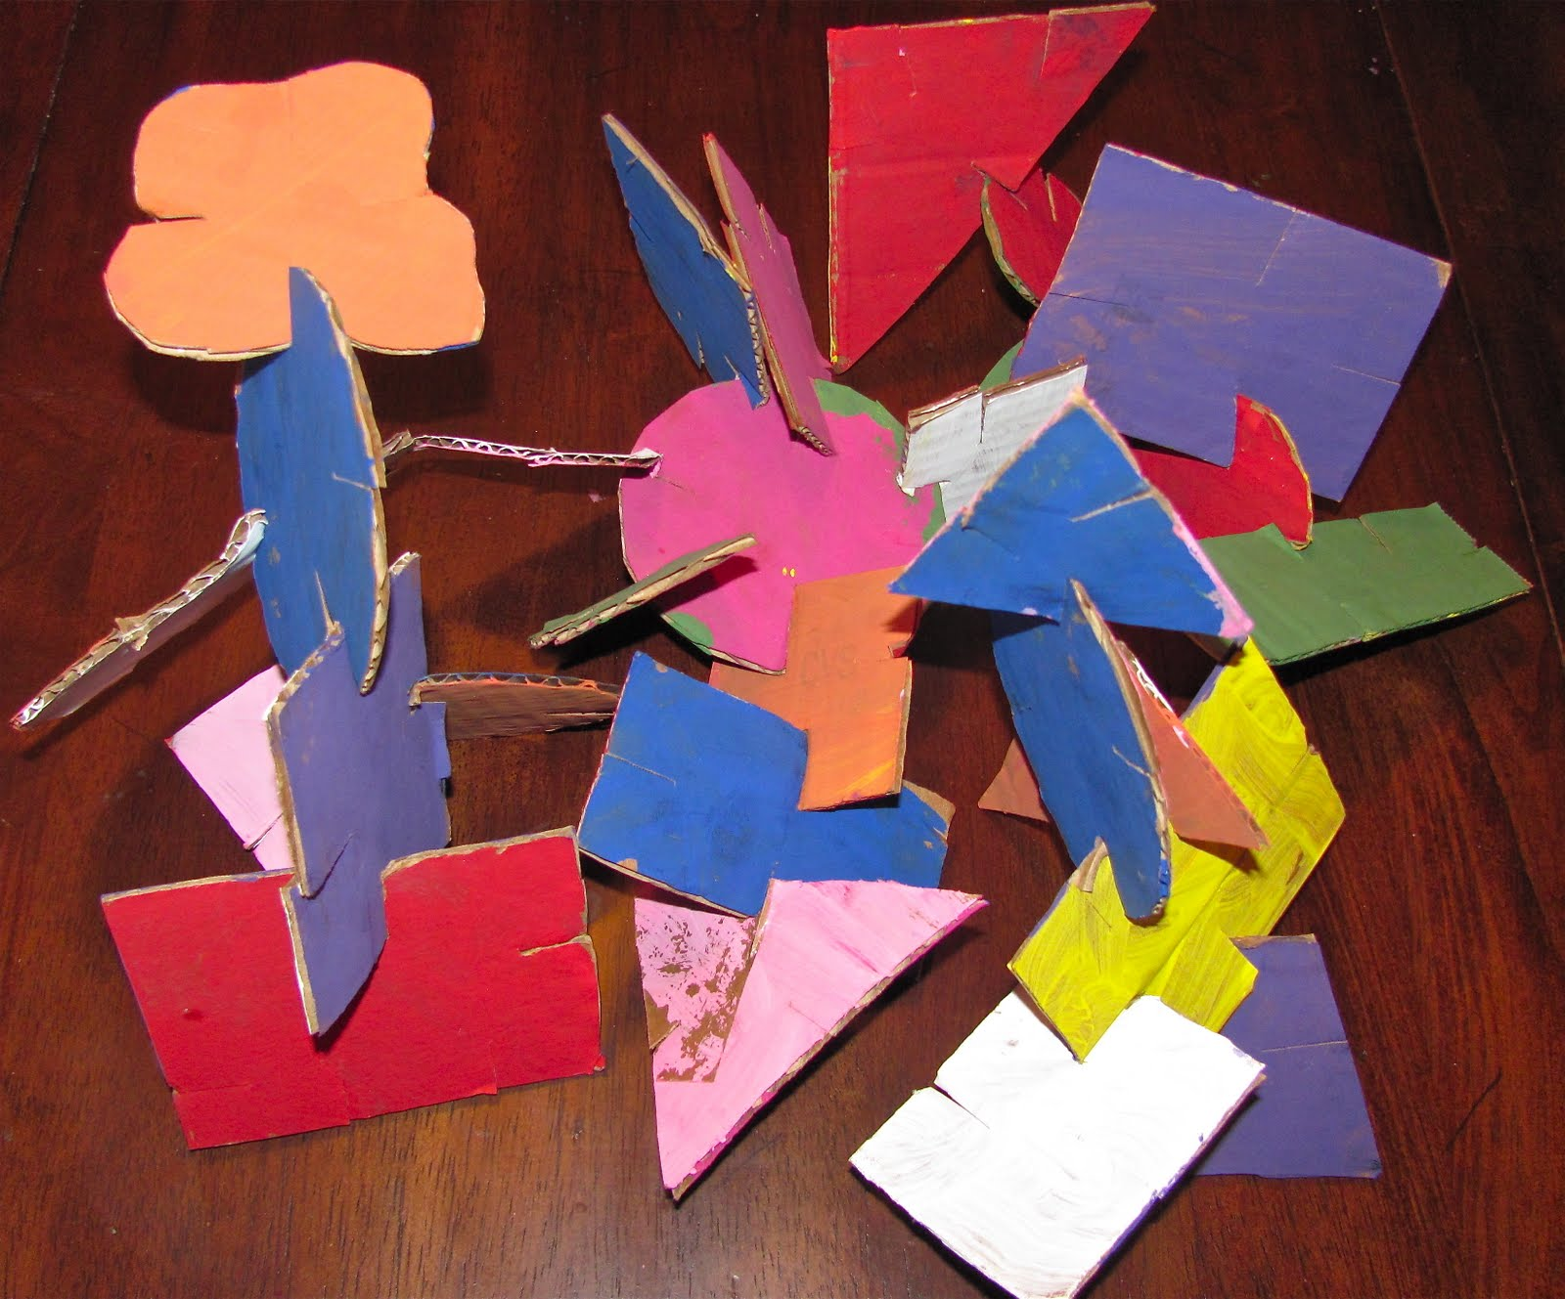

Slide 16
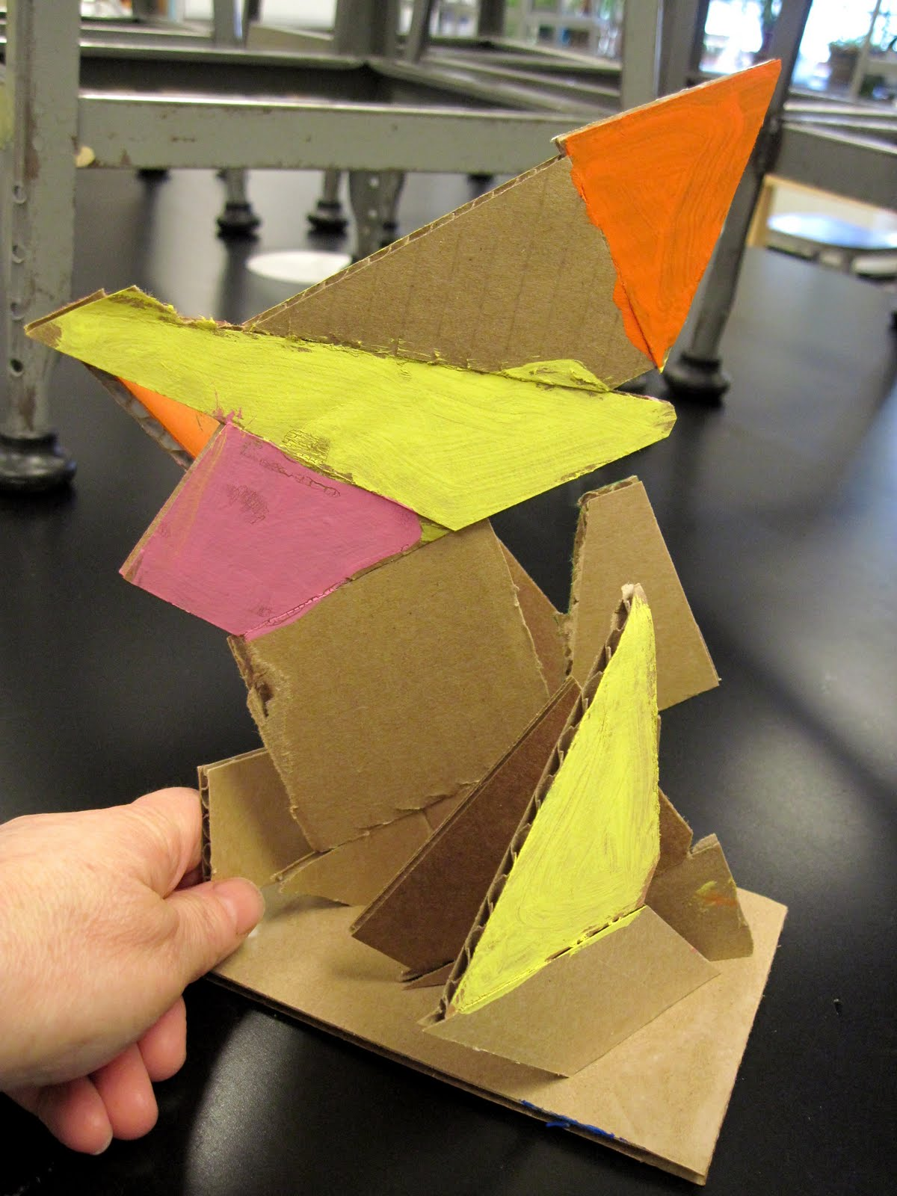

Slide 17
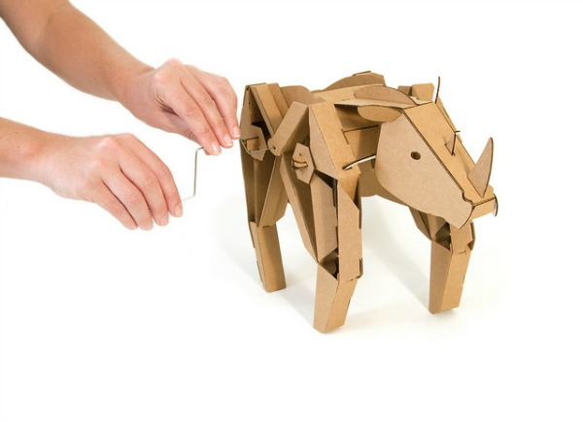

Slide 18
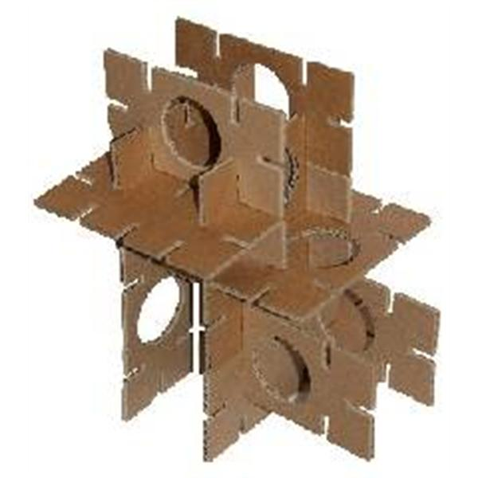
The finished piece must be able to stand on its own

Slide 19
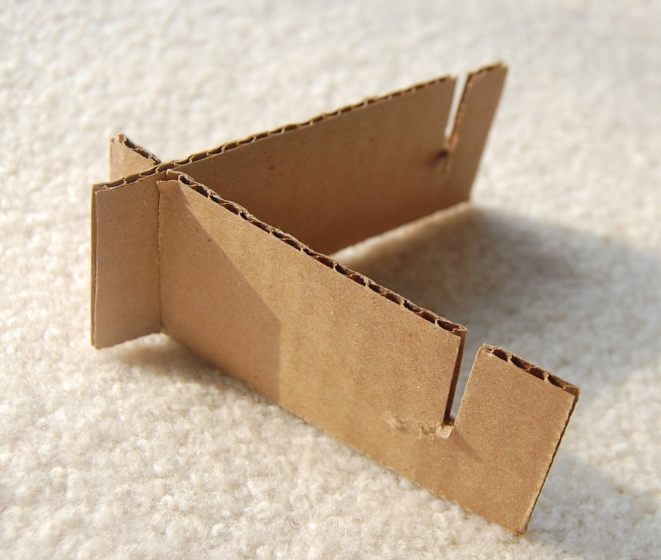
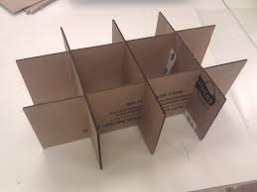
Interlocking slots (cut the width of the cardboard) provide support

Slide 20
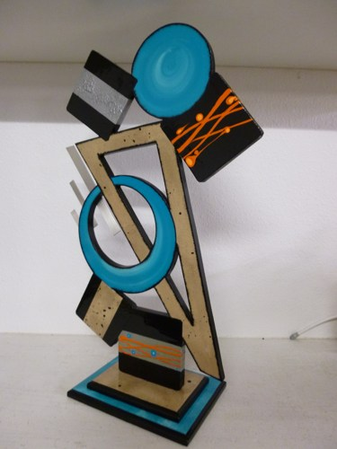
Once you have your idea for your sculpture, begin cutting your pieces out of cardboard

Slide 21
Once you have your idea for your sculpture, begin cutting your pieces out of cardboard
Figure out how the pieces will interlock by cutting slots and building the sculpture, piece by piece

Slide 22
Once you have your idea for your sculpture, begin cutting your pieces out of cardboard
Figure out how the pieces will interlock by cutting slots and building the sculpture, piece by piece
As you build it, the sculpture must keep its balance

Slide 23
Once you have your idea for your sculpture, begin cutting your pieces out of cardboard
Figure out how the pieces will interlock by cutting slots and building the sculpture, piece by piece
As you build it, the sculpture must keep its balance
Dismantle the sculpture and paint the pieces

Slide 24
Once you have your idea for your sculpture, begin cutting your pieces out of cardboard
Figure out how the pieces will interlock by cutting slots and building the sculpture, piece by piece
As you build it, the sculpture must keep its balance
Dismantle the sculpture and paint the pieces
When the pieces have dried, put the sculpture back together again

Slide 25
Cardboard Sculpture

