Slide 1
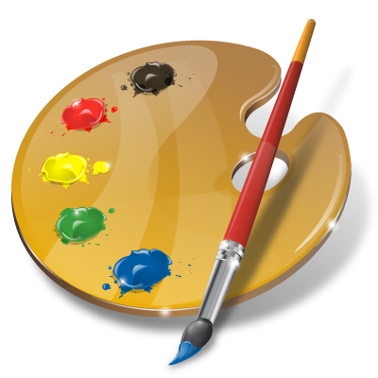
ILLUSTRATED WORDS

Slide 3
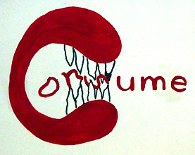

Slide 7
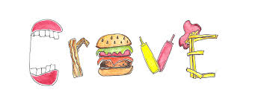

Slide 8
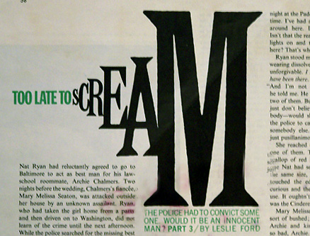

Slide 11
Select three words

Slide 12
Select three words
Verbs (showing an action) and adjectives (descriptive words) are the best

Slide 13
Select three words
Verbs (showing an action) and adjectives (descriptive words) are the best
“Illustrate” the words in a way that reflects their meaning

Slide 14
Select three words
Verbs (showing an action) and adjectives (descriptive words) are the best
“Illustrate” the words in a way that reflects their meaning
Choice of media open: Colored pencils, markers, paint, or any combination

Slide 15
Select three words
Verbs (showing an action) and adjectives (descriptive words) are the best
“Illustrate” the words in a way that reflects their meaning
Choice of media open: Colored pencils, markers, paint, or any combination
Begin with “thumbnail sketches” on newsprint, and show me your sketches of your words before you go to final

Slide 16
ILLUSTRATED WORDS

