Slide 2
Name Logo

Slide 3
A logo is a graphic mark or emblem commonly used by commercial enterprises, organizations and even individuals to aid and promote instant public recognition.

Slide 5
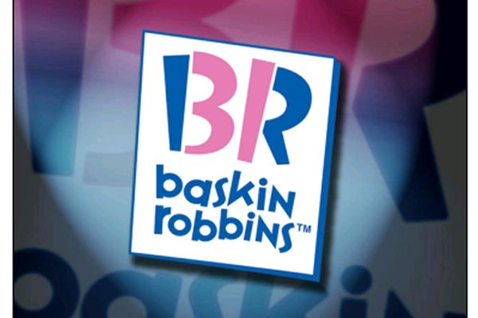

Slide 6
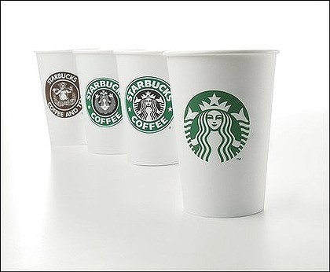

Slide 13
Create a logo using your first name

Slide 14
Create a logo using your first name
The logo should be a reflection of you – your personality and/or interests

Slide 15
Create a logo using your first name
The logo should be a reflection of you – your personality and/or interests
Minimum of two colors

Slide 16
Create a logo using your first name
The logo should be a reflection of you – your personality and/or interests
Minimum of two colors
Choice of media:
colored pencils, marking pens, tempera paint, construction paper, etc.

Slide 17
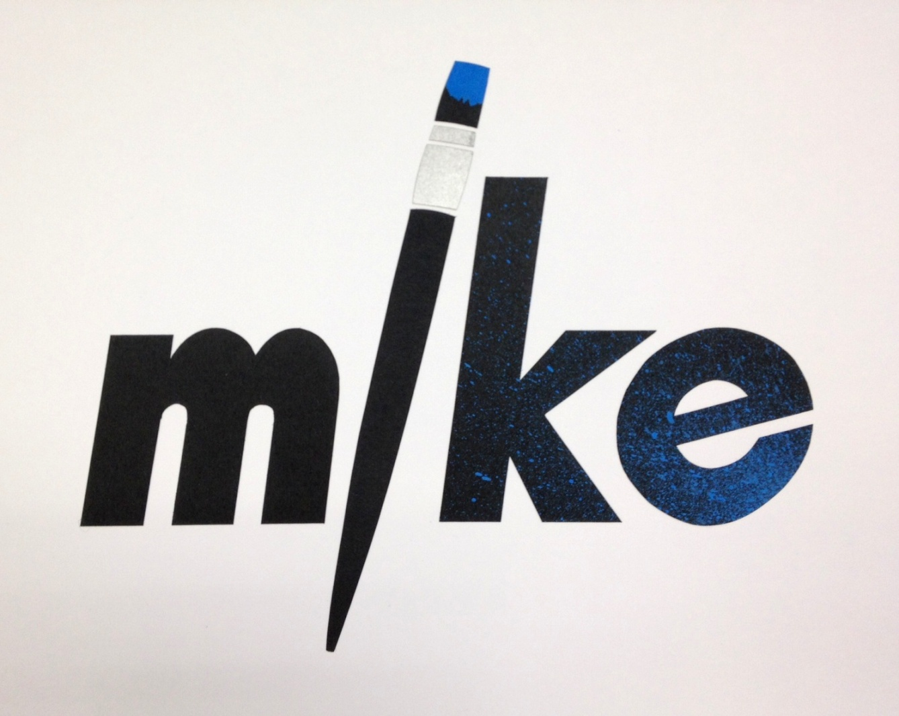

Slide 18
Name Logo

