Slide 1
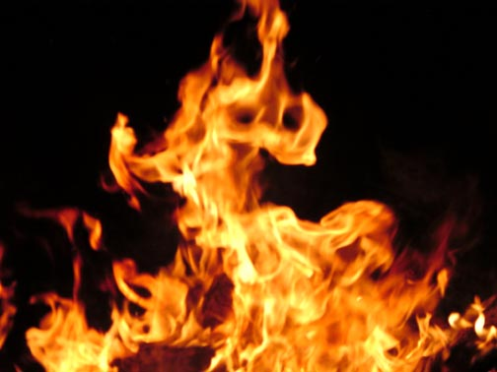
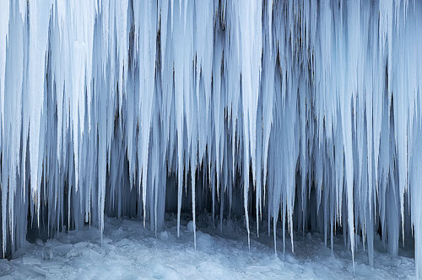

Slide 2
OPPOSING
VIEWPOINTS

Slide 3
Select a pair of opposites:

Slide 4
Select a pair of opposites:
Ancient/Modern Question/Answer Advance/Retreat
Asleep/Awake Beautiful/Ugly Dull/Sharp
Wet/Dry Dawn/Dusk Interior/Exterior
Gentle/Rough Optimist/Pessimist Wealth/Poverty
Gloomy/Cheerful Increase/Decrease Laugh/Cry
War/Peace Friend/Enemy Love/Hate
Life/Death Happiness/Sadness Hot/Cold
Crazy/Sane Old/New Fire/Ice
Fat/Thin Strong/Weak Silly/Serious
Quiet/Noisy Tame/Wild

Slide 6
Visually interpret each of them in a 6 x 13 ½ panel, for a total of 2 panels.

Slide 7
Visually interpret each of them in a 6 x 13 ½ panel, for a total of 2 panels.
Each panel will then be divided into thirds – 6 x 4 ½ each, making 6 panels

Slide 8
Visually interpret each of them in a 6 x 13 ½ panel, for a total of 2 panels.
Each panel will then be divided into thirds – 6 x 4 ½ each, making 6 panels
Arrange them in an “every other one” ziz-zag pattern.

Slide 9
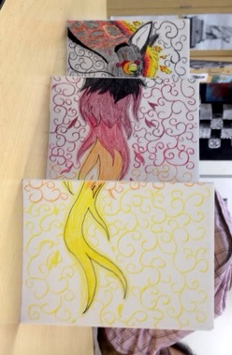
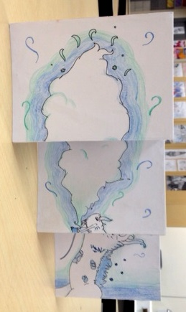
When viewed from one perspective, one term is visualized, from the other perspective, the opposite is viewed.

Slide 10
When viewed from one perspective, one term is visualized, from the other perspective, the opposite is viewed.
Choice of media open

Slide 11
OPPOSING
VIEWPOINTS

