Slide 2
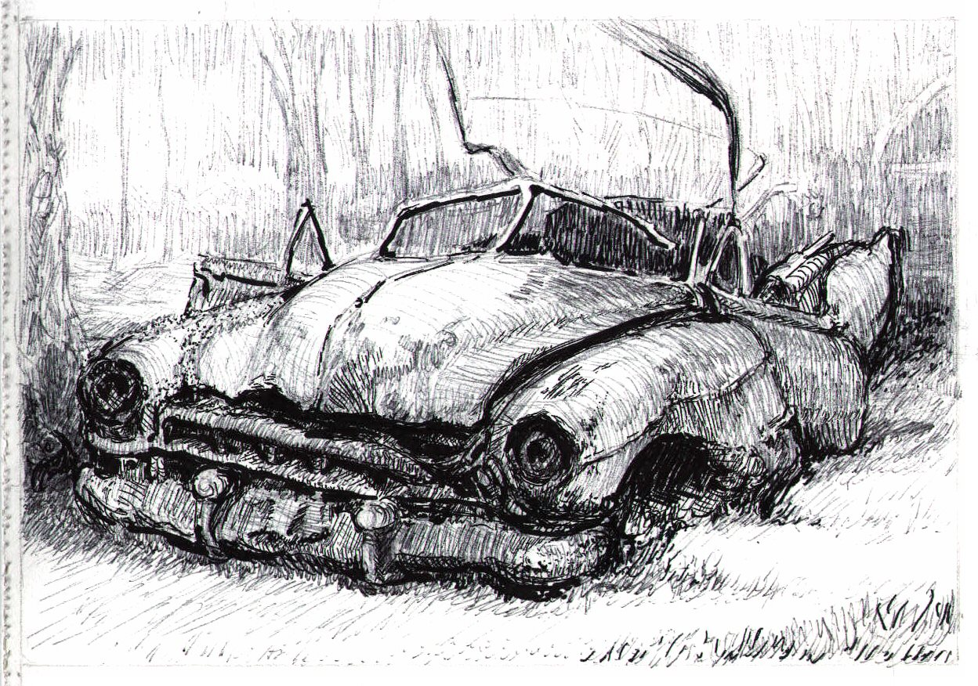

Slide 3
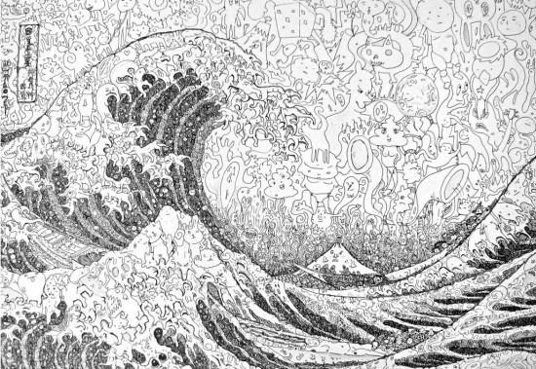

Slide 4
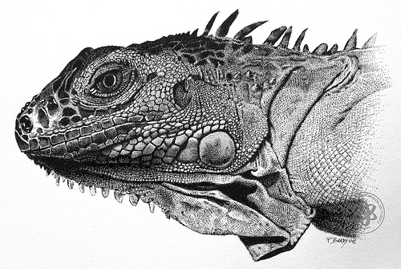

Slide 5
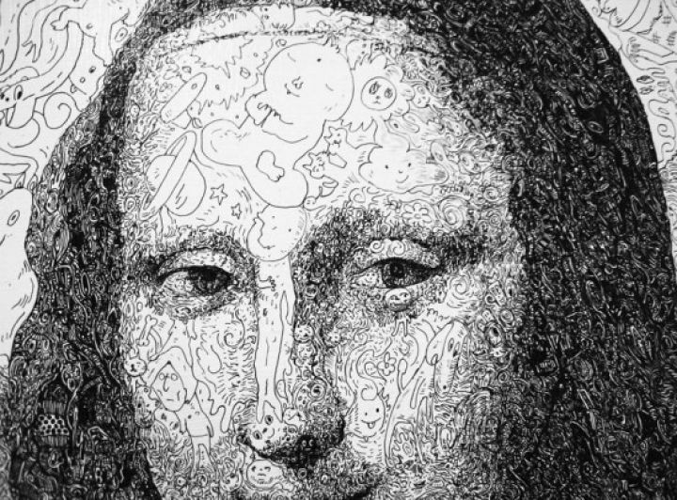

Slide 6
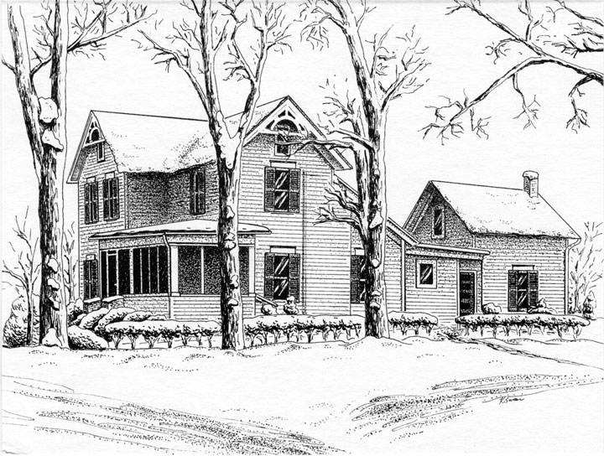

Slide 7
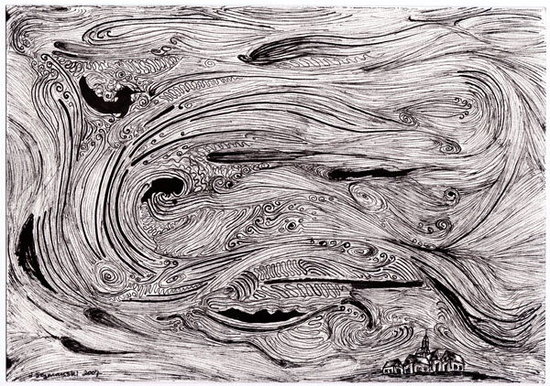

Slide 8
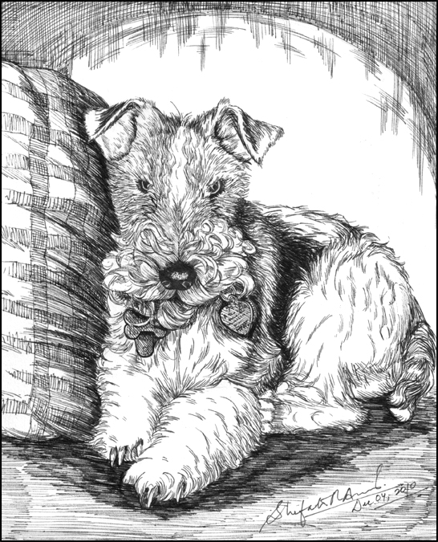

Slide 9
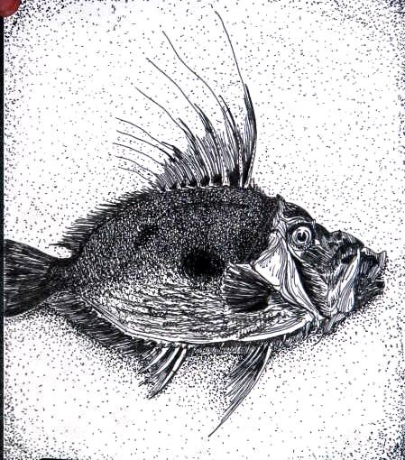

Slide 10
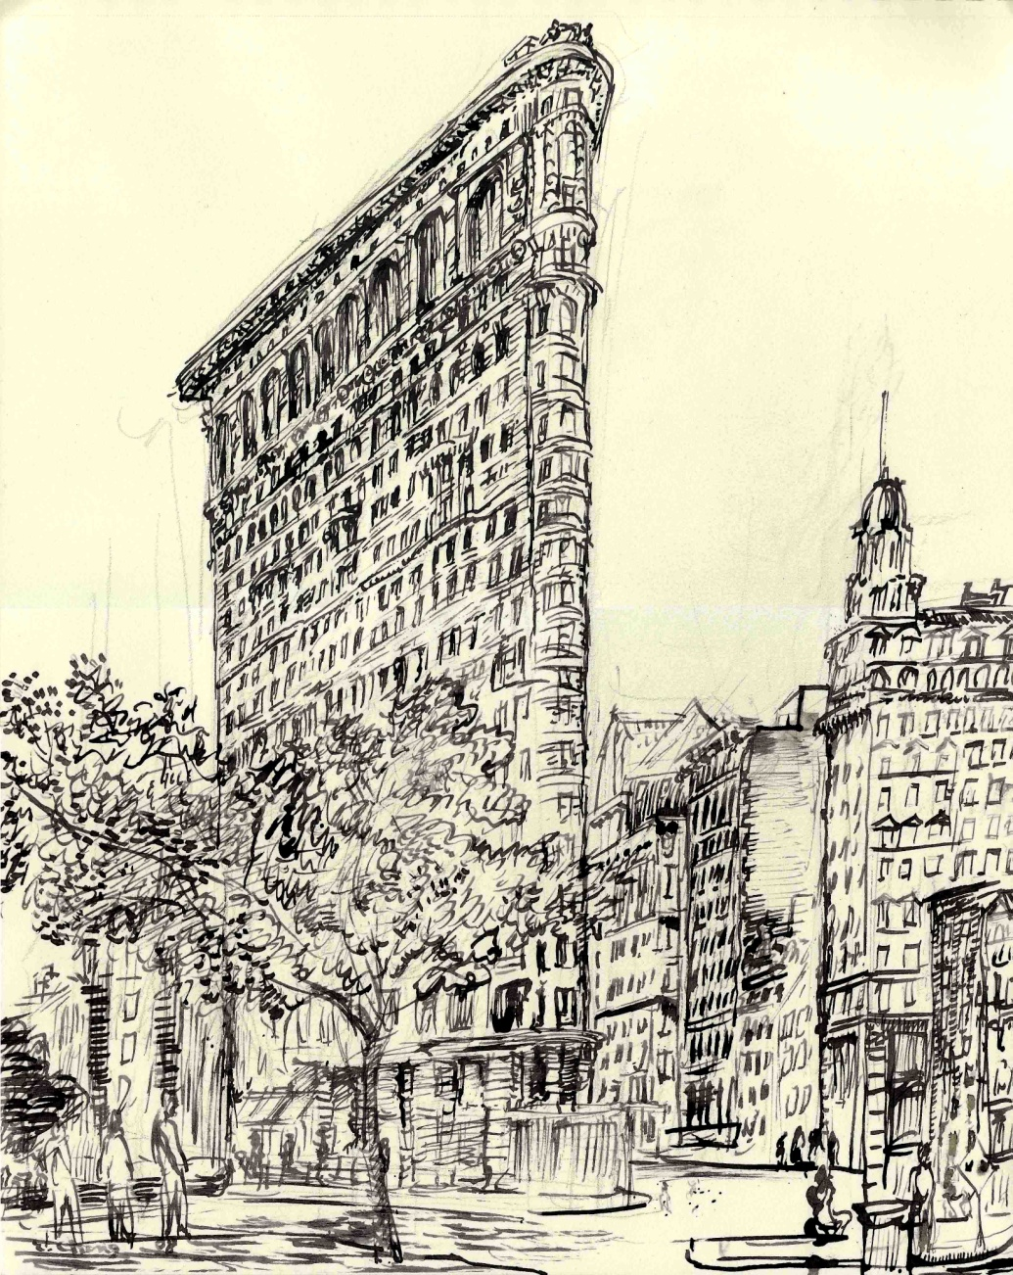

Slide 11
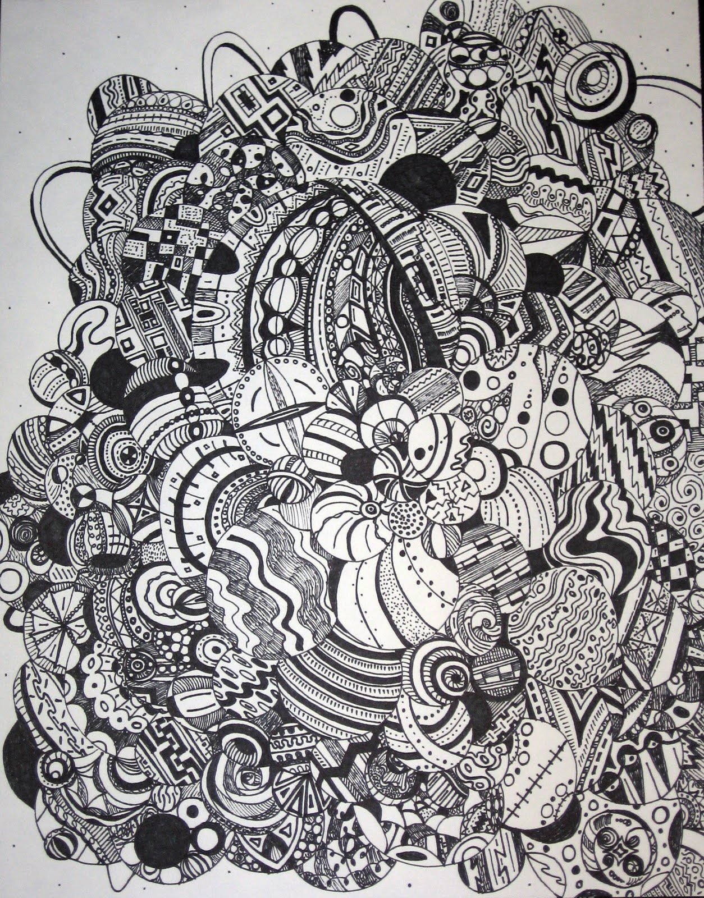

Slide 12
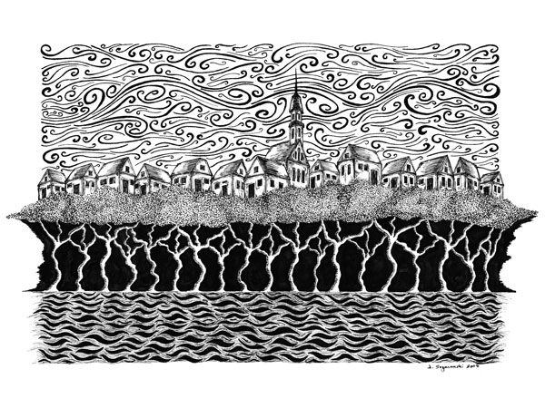

Slide 13
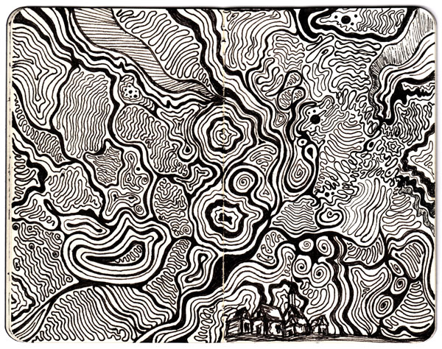

Slide 14
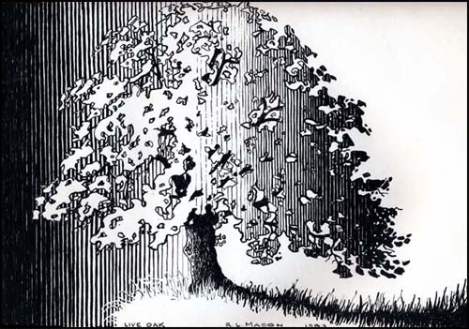

Slide 15
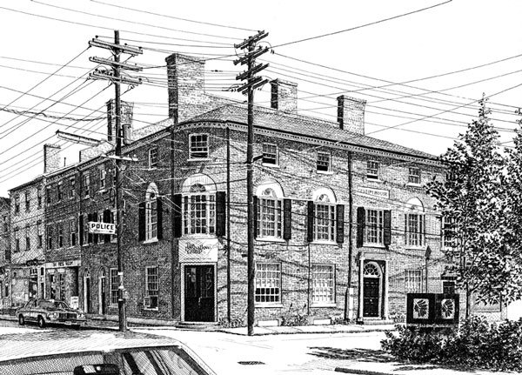

Slide 16
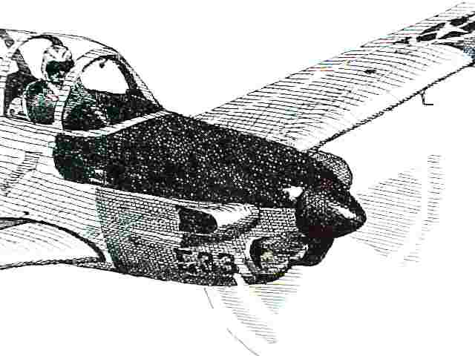

Slide 18
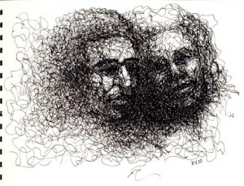

Slide 20
Pen & Ink techniques to try:

Slide 21
Pen & Ink techniques to try:
Hatching

Slide 22
Pen & Ink techniques to try:
Hatching
Cross hatching

Slide 23
Pen & Ink techniques to try:
Hatching
Cross hatching
Random lines

Slide 24
Pen & Ink techniques to try:
Hatching
Cross hatching
Random lines
Stippling

