Slide 1
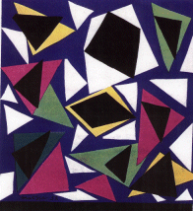
Principles
of Design

Slide 2
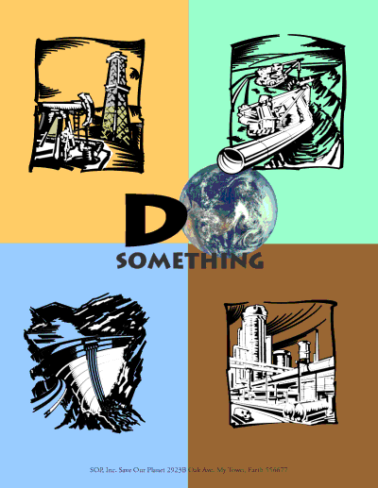
1. Balance

Slide 3
1. Balance
Elements of design converge to create a
design or arrangement of parts that
appear to be a whole with equalibrium.

Slide 4
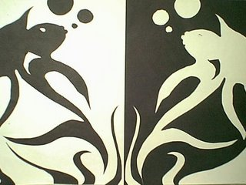
1a. Symmetrical
balance

Slide 5
1a. Symmetrical
balance
The state in which a work is identical on both halves.

Slide 6
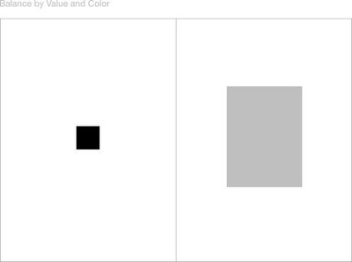
1b. Asymmetrical
balance

Slide 7
1b. Asymmetrical
balance
Though the piece is not identical on both sides, objects (or lack of object, colors, patterns, values) are balanced
with equally
weighted objects
on the other side.

Slide 8
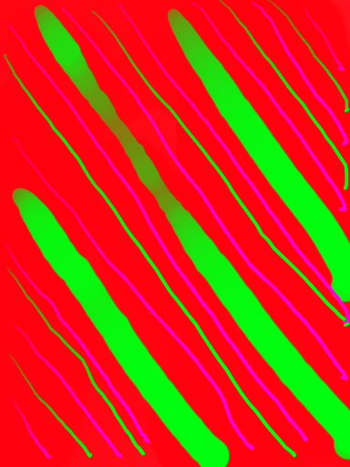
2. Contrast

Slide 9
2. Contrast
Used to create interest
and add excitement to
a work.

Slide 10
2. Contrast
Used to create interest
and add excitement to
a work. A striking
difference in value, size,
shape, color, texture, etc. offers variety within a visual format.

Slide 11
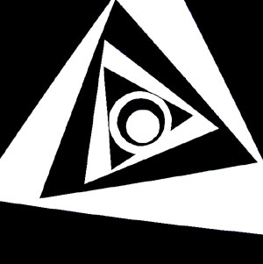
3. Focal point

Slide 12
3. Focal point
The place on the work of art to which
the viewer’s eye is drawn.

Slide 13
3. Focal point
The place on the work of art to which
the viewer’s eye is drawn. This can be
accomplished using
different principles of
design and elements
of art.

Slide 14
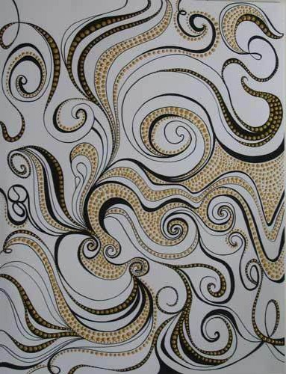
4. Movement

Slide 15
4. Movement
Visual movement is used by the artist to direct the viewer through the work, often to a focal point.

Slide 16
4. Movement
Visual movement is used by the artist to direct the viewer through the work, often to a focal point. Many of the elements of art (line, value, etc.) can be utilized to create movement in a piece.

Slide 17
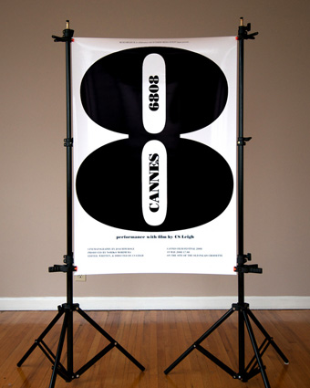
5. Emphasis

Slide 18
5. Emphasis
Also known as dominance.

Slide 19
5. Emphasis
Also known as dominance. This condition exists when an element or elements within a visual format contain a hierarchy of visual importance.

Slide 20
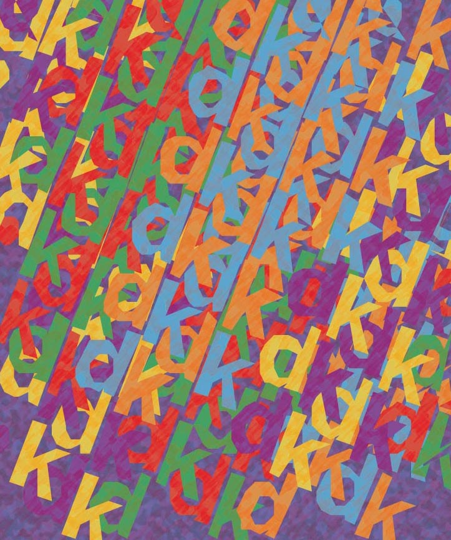
6. Rhythm

Slide 21
6. Rhythm
A recurrence or repetition
of one or more elements
within a visual format,
creating harmony.

Slide 22
6. Rhythm
A recurrence or repetition
of one or more elements
within a visual format,
creating harmony.
Movement and
rhythm used in conjunction can create the visual equivalent of music.

Slide 23
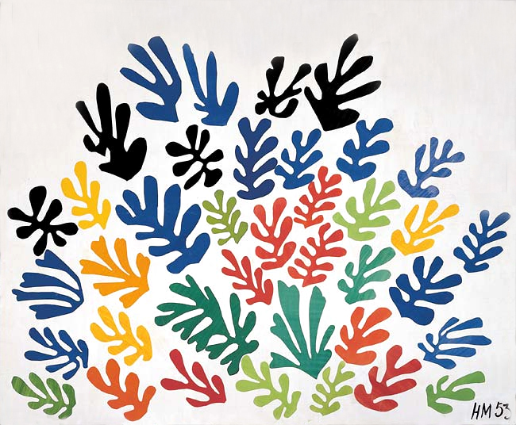
7. Pattern

Slide 24
7. Pattern
The repetition (either planned or occurring naturally) of other elements in art.

Slide 25
7. Pattern
The repetition (either planned or occurring naturally) of other elements in art. Often used to create interesting, stimulating surfaces in 2 and 3-dimensional art.

Slide 26
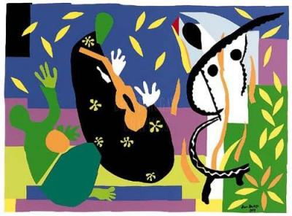
8. Unity

Slide 27
8. Unity
Oneness; harmony.

Slide 28
8. Unity
Oneness; harmony. The condition of completeness with the use of all visual elements within a format.

Slide 29
8. Unity
Oneness; harmony. The condition of completeness with the use of all visual elements within a format. The different components work together to create the whole effect.

Slide 30
Principles
of Design

