Slide 1
Tempera Batik

Slide 2
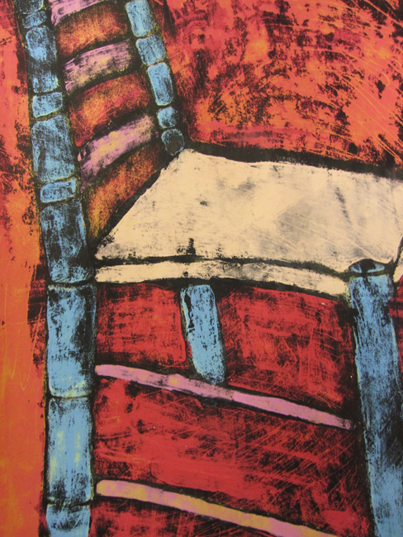

Slide 3
Sketch design

Slide 4
Sketch design
Go over with Sharpie

Slide 5
Sketch design
Go over with Sharpie
Fill in with tempera paint (don’t cover marker lines)

Slide 6
Sketch design
Go over with Sharpie
Fill in with tempera paint (don’t cover marker lines)
Paint over with waterproof India ink

Slide 7
Sketch design
Go over with Sharpie
Fill in with tempera paint (don’t cover marker lines)
Paint over with waterproof India ink
Dry overnight

Slide 8
Sketch design
Go over with Sharpie
Fill in with tempera paint (don’t cover marker lines)
Paint over with waterproof India ink
Dry overnight
Wash off in sink / light sponge

Slide 9
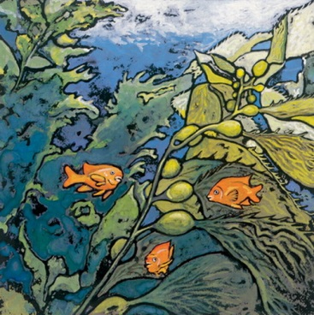

Slide 10
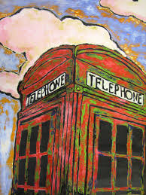

Slide 12
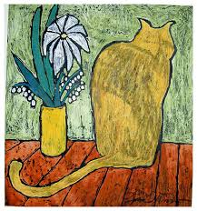

Slide 13
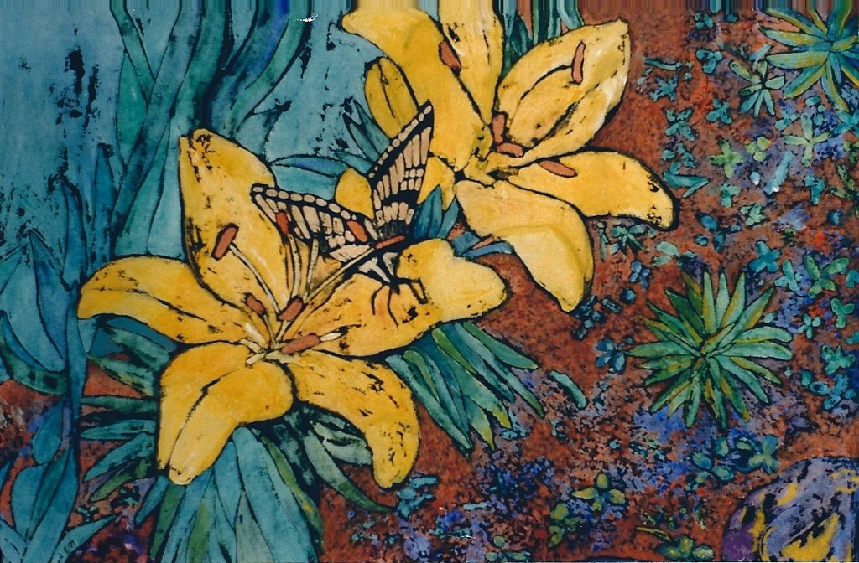

Slide 14
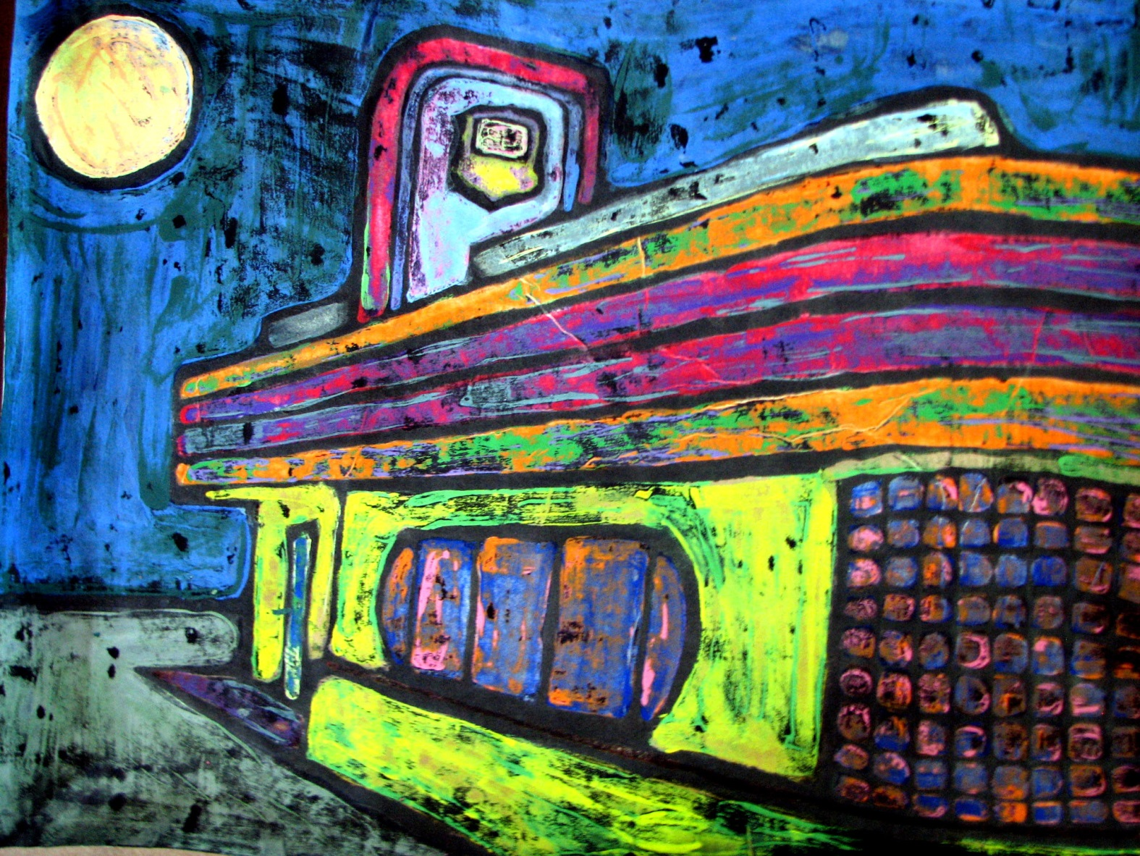

Slide 15
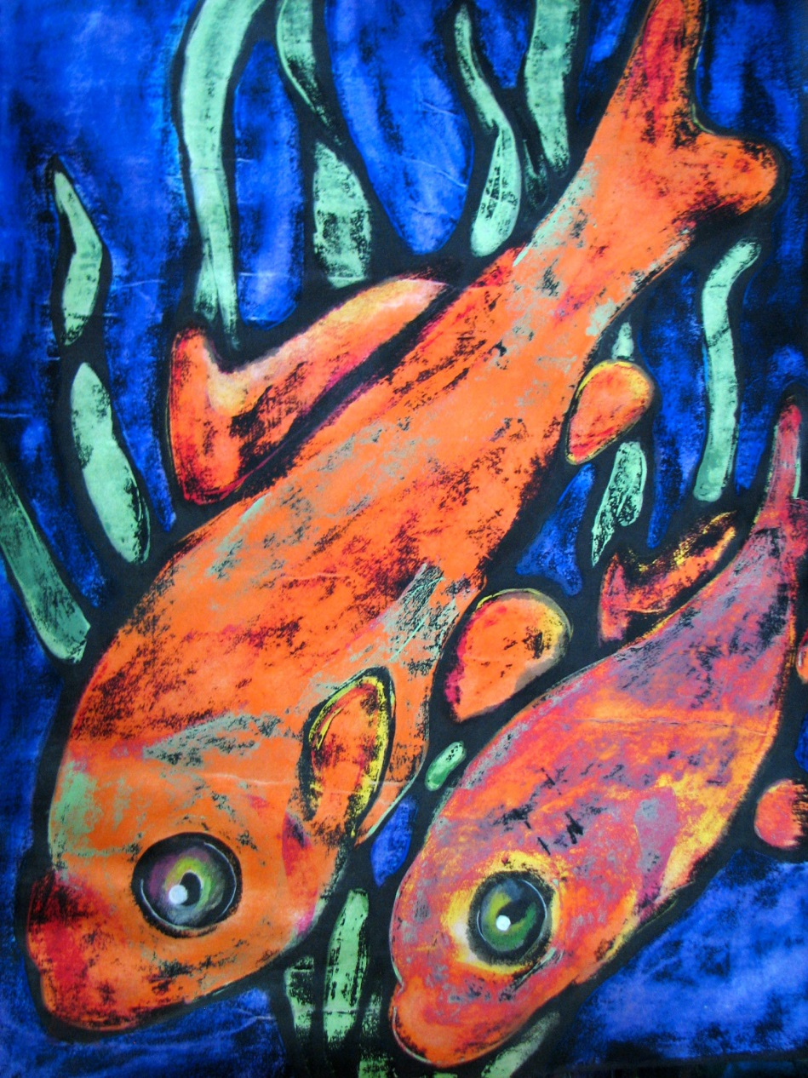

Slide 16
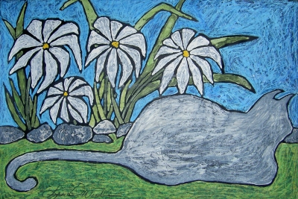

Slide 17
Tempera Batik

