Slide 1
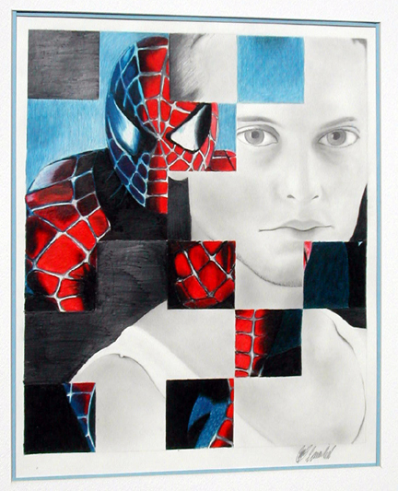
Weave Drawing

Slide 2
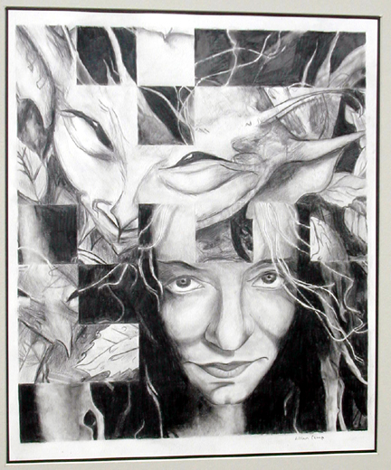
Choose two photographs

Slide 3
Choose two photographs
Try to find two that have a common theme or idea

Slide 4
Choose two photographs
Try to find two that have a common theme or idea
One should be predominantly darker, the other lighter

Slide 5
Choose two photographs
Try to find two that have a common theme or idea
One should be predominantly darker, the other lighter
Trim them to the same size that is in even inches

Slide 6
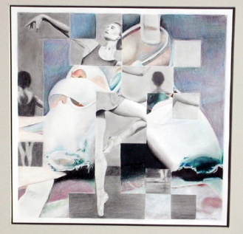
Cut the first picture into vertical 1” strips keeping them together at the top

Slide 7
Cut the first picture into vertical 1” strips keeping them together at the top
Place this first picture on a sheet of paper, taping it at the top

Slide 8
Cut the first picture into vertical 1” strips keeping them together at the top
Place this first picture on a sheet of paper, taping it at the top
Cut the second picture
horizontally in 1” strips

Slide 9
Cut the first picture into vertical 1” strips keeping them together at the top
Place this first picture on a sheet of paper, taping it at the top
Cut the second picture
horizontally in 1” strips
Take each horizontal strip and weave it in and out of the vertical strips, starting at the top

Slide 10
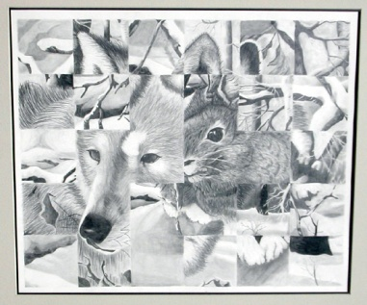
Decide as you go which square image is more important to expose at that point

Slide 11
Decide as you go which square image is more important to expose at that point
When satisfied with the placement of the horizontal strip, tape on both sides

Slide 12
Decide as you go which square image is more important to expose at that point
When satisfied with the placement of the horizontal strip, tape on both sides
Line up the second horizontal strip and repeat the process

Slide 13
Decide as you go which square image is more important to expose at that point
When satisfied with the placement of the horizontal strip, tape on both sides
Line up the second horizontal strip and repeat the process
When finished with horizontal strips, tape along the bottom to hold all strips in place

Slide 14
Decide as you go which square image is more important to expose at that point
When satisfied with the placement of the horizontal strip, tape on both sides
Line up the second horizontal strip and repeat the process
When finished with horizontal strips, tape along the bottom to hold all strips in place
You might eliminate rows at the top, bottom, or sides that are unimportant

Slide 15
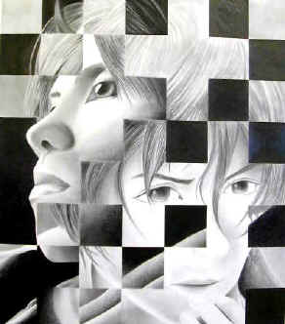
On a sheet of drawing paper, make a grid of 1 ½ to 2” squares, the same number of squares that is in the woven photographic design

Slide 16
On a sheet of drawing paper, make a grid of 1 ½ to 2” squares, the same number of squares that is in the woven photographic design
Transfer the design in pencil onto the drawing paper, square by square

Slide 17
On a sheet of drawing paper, make a grid of 1 ½ to 2” squares, the same number of squares that is in the woven photographic design
Transfer the design in pencil onto the drawing paper, square by square
Start with outline of hard-edged areas first, then add values (lights and darks)

Slide 18
On a sheet of drawing paper, make a grid of 1 ½ to 2” squares, the same number of squares that is in the woven photographic design
Transfer the design in pencil onto the drawing paper, square by square
Start with outline of hard-edged areas first, then add values (lights and darks)
Colored pencils for accents are optional

Slide 19
Weave Drawing

